Slide 1
Multicore OS
Acknowledgement: some slides taken from Kubiatowicz, Baumann and others

Slide 2
Uniprocessor Performance (SPECint)
3X
From Hennessy and Patterson, Computer Architecture: A Quantitative Approach, 4th edition, Sept. 15, 2006
⇒ Sea change in chip design: multiple “cores” or processors per chip
VAX : 25%/year 1978 to 1986
RISC + x86: 52%/year 1986 to 2002
RISC + x86: ??%/year 2002 to present
Notes:
Corey, fOS, HeliOS, Tessellation and Barrelfish
essellation OS

Slide 3
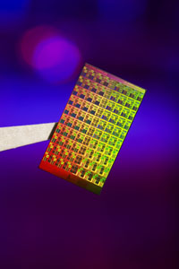
ManyCore Chips: The future is here
Intel 80-core multicore chip (Feb 2007)
80 simple cores
Two floating point engines /core
Mesh-like "network-on-a-chip“
100 million transistors
65nm feature size
“ManyCore” refers to many processors/chip
64? 128? Hard to say exact boundary
How to program these?
Use 2 CPUs for video/audio
Use 1 for word processor, 1 for browser
76 for virus checking???
Something new is clearly needed here…

Slide 4
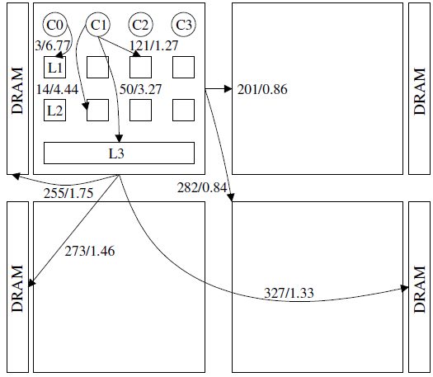
The AMD 4-Socket, 16-Core Processor
Memory access latency is in cycles and listed before the backslash.
Memory bandwidth is in bytes per cycle and listed after the backslash.

Slide 5
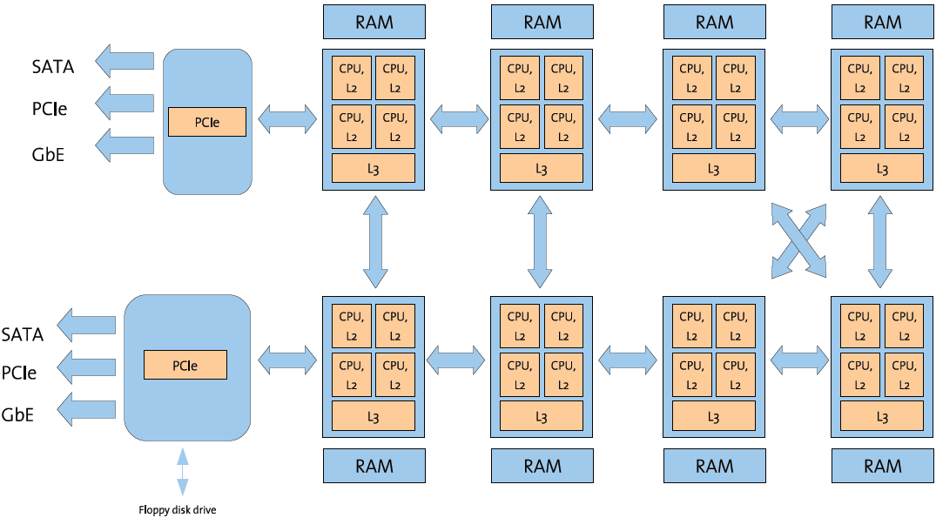
Intel 8-Socket, 32-Core Opteron Processor
Notes:
Why is the presence of ManyCore a problem?
Parallel computing has been around for 40 years with mixed results
Many researchers, several generations, widely varying approaches
Parallel computing has never become a generic software solution (especially for client applications)
Suddenly, parallel computing will appear at all levels of our computation stack
Cellphones
Cars (yes, Bosch is thinking of replacing some of the 70 processors in a high end car with ManyCore chips)
Laptops, Desktops, Servers…
Time for the computer industry to panic a bit???
Perhaps

Slide 6
Older MicroKernel OSes
Common theme:
Small kernel, narrow system call interface
OS services run in user-mode servers
Drivers, file systems
Communication is exclusively through IPC (Inter-Process Communication), not shared memory
Representative examples:
Mach: the first one
Exo-kernel
Minix: for teaching OS, improved reliability
L4: fast IPC
EROS: improved security
Singularity: use compiler/type safety

Slide 7
Comeback of Micro-Kernels
Recent research OSes are mostly micro-kernels
Corey (MIT) - 2008
Extends exo-kernel
Tessillation (Berkeley) – 2009
Barrelfish (ETHZ, Microsoft) - 2009
Extends (Corey, SeL4, Helios)
Helios (Microsoft) - 2009
Extends Singularity
Better security
OP Brower – 2008
Extends Mach/Minix
seL4 – 2009
Extends L4
Illinois Brower OS – 2010
Extends L4
Notes:
The Factored Operating System (fos) [76] (from MIT) is targeted at creating an highly scalable operating system for many-cores computing systems.
Corey [79] is another project developed at MIT and it proposes a different management of data structures to reduce the performance footprint of the OS in multicore systems.
Barrelfish [14] is developed at Eidgenoessische Technische Hochschule, Zurich (ETH, Zurich) in collaboration with Microsoft research at Cambridge and it proposes an operating system design referred to as the multikernel.
Microsoft Helios [56] targets heterogeneous systems which can be managed with satellite kernels, an idea analogue to Barrelfish’s multikernel.

Slide 8
Tessellation OS (UC Berkeley)
Tessellation: Space-Time Partitioning in a Manycore Client OS, R. Liu, K. Klues, S. Bird, S. Hofmeyr, K. Asanovic, and J. Kubiatowicz. Appears in First USENIX Conference on Hot Topics in Parallelism, HotPAR, 2009

Slide 9
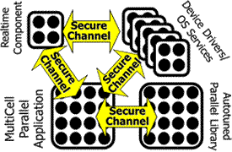
Tessellation OS Outline
Space-Time Partitioning
RAPPidS goals
Partitions, QoS, and Two-Level Scheduling
The Cell Model
Space-Time Resource Graph
User-Level Scheduling Support (Lithe)
Tessellation implementation
Hardware Support
Tessellation Software Stack
Status

Slide 10
The Problem with Current OSs
What is wrong with current Operating Systems?
They do not allow expression of application requirements
Minimal Frame Rate, Minimal Memory Bandwidth, Minimal QoS from system Services, Real Time Constraints, …
No clean interfaces for reflecting these requirements
They do not provide guarantees that applications can use
They do not provide performance isolation
Resources can be removed or decreased without permission
Maximum response time to events cannot be characterized
They do not provide fully custom scheduling
In a parallel programming environment, ideal scheduling can depend crucially on the programming model
They do not provide sufficient security or correctness
Monolithic Kernels get compromised all the time
Applications cannot express domains of trust within themselves without using a heavyweight process model
The advent of ManyCore both:
Exacerbates the above with a greater number of shared resources
Provides an opportunity to change the fundamental model

Slide 11
Spatial Partitioning
Spatial Partition: group of processors acting within hardware boundary
Boundaries are “hard”, communication between partitions controlled
Anything goes within partition
Each Partition receives a vector of resources
Some number of dedicated processors
Some set of dedicated resources (exclusive access)
Complete access to certain hardware devices
Dedicated raw storage partition
Some guaranteed fraction of other resources (QoS guarantee):
Memory bandwidth, Network bandwidth
fractional services from other partitions

Slide 12
Defining the Partitioned Environment
Cell: a bundle of code, with guaranteed resources, running at user level
Has full control over resources it owns (“Bare Metal”)
Contains at least one address space (memory protection domain), but could contain more than one
Contains a set of secured channel endpoints to other Cells
Interacts with trusted layers of Tessellation (e.g. the “NanoVisor”) via a heavily Paravirtualized Interface
E.g. Can manipulate its address mappings but does not know what page tables even look like
We think of these as components of an application or the OS
When mapped to the hardware, a cell gets:
Gang-scheduled (co-scheduled) hardware thread resources (“Harts”)
Guaranteed fractions of other physical resources
Physical Pages (DRAM), Cache partitions, memory bandwidth, power
Guaranteed fractions of system services

Slide 13
Inter-Cell Communication
We are interested in communication for many reasons:
Communication crosses resource and security boundaries
Efficiency of communication impacts (de)composability
Shared components complicate resource isolation:
Need distributed mechanism for tracking and accounting of resources
E.g.: How guarantee that each partition gets guaranteed fraction of service?
How does presence of a message impact Cell activation?
Not at all (regular activation) or immediate change (interrupt-like)
Communication defines Security Model
Mandatory Access Control Tagging (levels of information confidentiality)
Ring-based security (enforce call-gate structure with channels)
Application A
Secure
Channel
Shared File Service
Secure
Channel
Application B

Slide 14
Resource Composition
Secure
Channel
Device Drivers
Secure
Channel
Real-Time Cells
(Audio, Video)
Secure
Channel
Secure
Channel
Secure
Channel
Parallel Library
Core Application
File Service
Component-based model of computation
Applications consist of interacting components
Produces composable: Performance, Interfaces, Security
CoResident Cells ⇒ fast inter-domain communication
Could use hardware acceleration for fast secure messaging
Applications could be split into mutually distrusting partitions w/ controlled communication (echoes of μKernels)
Fast Parallel Computation within Cells
Protection of computing resources not required within partition
High walls between partitions ⇒ anything goes within partition
Shared Memory/Message Passing/whatever within partition
Natural Extension to Cloud
Services can either be local or remote

Slide 15
Cell ABI
The set of interfaces between software component and system
Perhaps “Cell or Component Binary Interface” (CBI)?
Interfaces with User-Level Runtime
Start partition, stop partition, resource removal request
Standard format/location for processor state storage
Allow suspension/resumption of partition by Tessellation
Allow resumption of partition with less processor resources than before
User-level event delivery mechanisms (like user-level interrupt)
Deliver interrupts directly to User-Level runtime
One or more queues of events
Ability to perform user-level disable of event delivery
Message arrival, timer expiration, page faults
Designated receiver within partition (since channels are Cell ⇔ Cell)
Channel interfaces
Connect with named service (either local or remote)
Message transmission, Reception options (interrupt, interrupt on Cell active, polled)
SLA request, Return

Slide 16
Cell ABI (Con’t)
Paravirtualized machine interfaces
Access to page mappings, construction of address spaces
User-level interrupt disable mechanisms
Cell spawning/Dynamic Library Interfaces
“Adaptive Task”
Support for dynamic adaptation and autotuning
i.e. SEJITS
Ability to perform performance tests, compilation
Ability to access cached pre-tuned versions of code (local or cloud)
On-the-fly linking into running binary
Resource specification and reporting interfaces
Requirements, Policies
Progress Reporting / Progress expectation
Promise (SLA) return
Resource Revocation/Renegotiation
Information about what is about to happen

Slide 17
Two Level Scheduling
Resource Allocation
And
Distribution
Monolithic
CPU and Resource
Scheduling
Two-Level Scheduling
Application Specific Scheduling
Split monolithic scheduling into two pieces:
Course-Grained Resource Allocation and Distribution
Chunks of resources (CPUs, Memory Bandwidth, QoS to Services) distributed to application (system) components
Option to simply turn off unused resources (Important for Power)
Based on Constant Bandwidth Server (CBS) on EDF
Fine-Grained Application-Specific Scheduling
Applications are allowed to utilize their resources in any way they see fit
Other components of the system cannot interfere with their use of resources

Slide 18
Two-Level Scheduling (Cont’)
First Level: Gross partitioning of resources
Goals: Power Budget, Overall Responsiveness/QoS, Security
Partitioning of CPUs, Memory, Interrupts, Devices, other resources
Constant for sufficient period of time to:
Amortize cost of global decision making
Allow time for partition-level scheduling to be effective
Hard boundaries ⇒ interference-free use of resources for quanta
Allows AutoTuning of code to work well in partition
Second Level: Application-Specific Scheduling
Goals: Performance, Real-time Behavior, Responsiveness, Predictability
CPU scheduling tuned to specific applications
Resources distributed in application-specific fashion
External events (I/O, active messages, etc) deferrable as appropriate
Justifications for two-level scheduling?
Global/cross-app decisions made by 1st level
E.g. Save power by focusing I/O handling to smaller number of cores
App-scheduler (2nd level) better tuned to application
Lower overhead/better match to app than global scheduler
No global scheduler could handle all applications

Slide 19
Space-Time Partitioning
Space
Time
Space
Spatial Partitioning Varies over Time
Partitioning adapts to needs of the system
Some partitions persist, others change with time
Further, Partititions can be Time Multiplexed
Services (i.e. file system), device drivers, hard realtime partitions
Some user-level schedulers will time-multiplex threads within a partition
Global Partitioning Goals:
Power-performance tradeoffs
Setup to achieve QoS and/or Responsiveness guarantees
Isolation of real-time partitions for better guarantees

Slide 20
Tessellation Architecture
Application
Or
OS Service
Library OS
Functionality
Custom
Scheduler
Sched
Reqs.
Comm.
Reqs
Res.
Reqs.
Partition
Resizing
Callback API
Partition
Management
Layer
Partition
Scheduler
Partition
Allocator
Tessellation
Kernel
Partition
Mechanism
Layer
(Trusted)
Configure Partition
Resources enforced by
HW at runtime
Configure
HW-supported
Communication
Interconnect
Bandwidth
Message
Passing
Cache
Physical
Memory
CPUs
Performance
Counters
Hardware Partitioning Mechanisms
20
Notes:
Applications can also specify other scheduling requirements to the Partition Scheduler, such as being run at a periodic time interval.

Slide 21
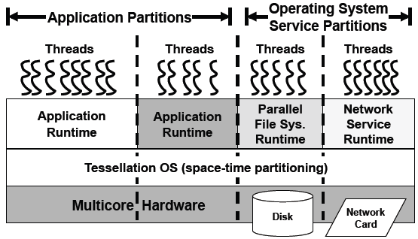
Tessellation Architecture Example

Slide 22
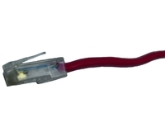

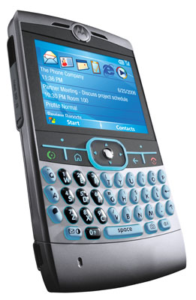


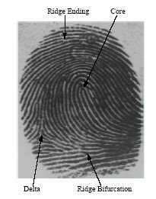

Tessellation: The Exploded OS
Normal Components split into pieces
Device drivers (Security/Reliability)
Network Services (Performance)
TCP/IP stack
Firewall
Virus Checking
Intrusion Detection
Persistent Storage (Performance, Security, Reliability)
Monitoring services
Performance counters
Introspection
Identity/Environment services (Security)
Biometric, GPS, Possession Tracking
Applications Given Larger Partitions
Freedom to use resources arbitrarily
Large Compute-Bound
Application
Firewall
Virus
Intrusion
Monitor
And
Adapt
Real-Time
Application
Video &
Window
Drivers
Persistent
Storage &
File System
Identity
HCI/
Voice
Rec
Device
Drivers

Slide 23

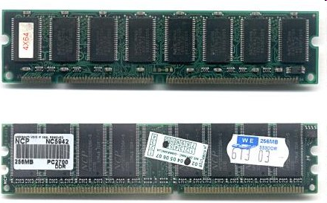
Tessellation in Server Environment
QoS
Guarantees
Large Compute-Bound
Application
Network QoS
Large Compute-Bound
Application
Network QoS
QoS
Guarantees
Large Compute-Bound
Application
Network QoS
Large Compute-Bound
Application
Network QoS
Monitor
And
Adapt
Monitor
And
Adapt
Cloud Storage
BW QoS
Monitor
And
Adapt
Large I/O-Bound
Application
Other
Devices
Monitor
And
Adapt
Large I/O-Bound
Application
Other
Devices
Large I/O-Bound
Application
Other
Devices
Large I/O-Bound
Application
Other
Devices
Persistent Storage &
Parallel File System
Disk
I/O
Drivers
Persistent Storage &
Parallel File System
Disk
I/O
Drivers
Persistent Storage &
Parallel File System
Disk
I/O
Drivers
Persistent Storage &
Parallel File System
Disk
I/O
Drivers
QoS
Guarantees
QoS
Guarantees

Slide 24
Space-Time Resource Graph
Cell 1
Cell 3
Resources:
4 Proc, 50% time
1GB network BW
25% File Server
Parent/child
Spawning
relationship
Cell 2
Cell 3
Lightweight
Protection Domains
Space-Time resource graph: the explicit instantiation of resource assignments
Directed Arrows Express Parent/Child Spawning Relationship
All resources have a Space/Time component
E.g. X Processors/fraction of time, or Y Bytes/Sec
What does it mean to give resources to a Cell?
The Cell has a position in the Space-Time resource graph and
The resources are added to the cell’s resource label
Resources cannot be taken away except via explicit APIs

Slide 25
Implementing the Space-Time Graph
Partition Policy layer (allocation)
Allocates Resources to Cells based on Global policies
Produces only implementable space-time resource graphs
May deny resources to a cell that requests them (admission control)
Mapping layer (distribution)
Time-Slices at a coarse granularity (when time-slicing necessary)
Performs bin-packing like operation to implement space-time graph
In limit of many processors, no time multiplexing processors, merely distributing resources
Partition Mechanism Layer
Implements hardware partitions and secure channels
Device Dependent: Makes use of more or less hardware support for QoS and Partitions
Partition Policy Layer
(Resource Allocator)
Reflects Global Goals
Space-Time Resource Graph
Mapping Layer (Resource Distributer)
Space
Time
Space
Partition Mechanism Layer
ParaVirtualized Hardware
To Support Partitions
Notes:
Makes no decisions

Slide 26
Resource Allocation Architecture
Cell Creation
and Resizing
Requests
From Users
Major
Change
Request
Admission
Control
Resource Allocation
And Adaptation
Mechanism
Global Policies / User Policies and
Preferences
ACK/NACK
ACK/NACK
Minor
Changes
Space-Time Resource Graph (STRG)
All system resources
Policy Service
Online
Performance
Monitoring, Model Building,
and Prediction
Offline Models
and Behavioral
Parameters
Cell group with fraction of resources
Cell
Cell
Cell
Cell
(Current Resources)
Partition
Mapping and
Multiplexing
Layer
STRG Validator Resource Planner
Partition Multiplexing
Tessellation
Kernel (Trusted)
Partition
Mechanism
Layer
Partition
Implementation
QoS
Enforcement
Channel
Authenticator
Network
Bandwidth
Cache/
Local Store
Physical
Memory
Cores
Disks
NICs
Performance
Counters
Partitionable Hardware Resources

Slide 27
Guaranteed Resources
What resource guarantees?
Number of processors/fraction of processor time
Memory BW, Cache, Network BW (needs HW)
Access to accelerator resources (GPU, Crypto, etc)
QoS to services (Shared Lib, FileSystem, DB server, Cloud Services)
What might we put into our Service Level Agreements (SLAs)?
Can we use Internet services as a model?
Examples:
Guarantees of BW (say data committed to Cloud Storage)
Guarantees of Requests/Unit time (DB service)
Guarantees of Latency to Response (Deadline scheduling)
What level of guarantee?
Hard Guarantee? (Hard to do)
Soft Guarantee? (Better than existing systems)
With high confidence (specified), Maximum deviation, etc.
Impedance-mismatch problem
The SLA guarantees properties that programmer/user wants
The resources required to satisfy SLA are not things that programmer/user really understands

Slide 28
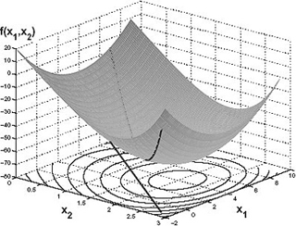
Modeling and Adaptation Policies
Adaptation
Convex optimization
Relative importance of different Cells expressed via scaling functions (“Urgency”)
Walk through Configuration space
Meet minimum QoS properties first, enhancement with excess resources
User-Level Policies
Declarative language for describing application preferences and adaptive desires
Modeling of Applications
Static Profiling: may be useful with Cell guarantees
Multi-variable model building
Get performance as function of resources
Or – tangent plane of performance as function of resources

Slide 29
Policies “User” might want to express
Need progress X on measurement Y
i.e. need 5 frames/second (where frame rate measured by application)
When Battery below 20%, slow usage of everything but application Z
i.e. below 20%, only voice calls work normally
When in location X, give higher priority to Y over Z
i.e. when in car, higher priority to GPS than web browser
Tradeoffs between types of apps:
Video quality more important than email poll rate
Should always be able to make 911 calls
Whatever happens, I want my battery to last until midnight
Profile managers for new Android phones very interesting
Allow user-visible properties (ringtones, screen brightness, volume, even whole apps) to be set based on situations
Possible situational information:
GPS location, battery power, docked/not docked, time, user profile selection, …

Slide 30
What happens in a Cell Stays in a Cell
Cells are performance and security isolated from all other cells
Processors and resources are gang-scheduled
All fine-grained scheduling done by a user-level scheduler
Unpredictable resource virtualization does not occur
Example: no paging without linking a paging library
Cells can control delivery of all events
Message arrivals (along channels)
Page faults, timer interrupts (for user-level preemptive scheduling), exceptions, etc
Cells start with single protection domain, but can request more as desired
Initial protection domain becomes primary
For now, protection domains are Address Spaces, but can be other things as well
CellOS: A layer of code within a Cell that looks like a traditional OS
Not required for all Cells!
On Demand Paging, Address Space management, Preemptive scheduling of multiple address spaces (i.e. processes)

Slide 31
Scheduling inside a cell
Cell Scheduler can rely on:
Time quanta allowing efficient fine-grained use of resources
Gang-Scheduling of processors within a cell
No unexpected removal of resources
Full Control over arrival of events
Can disable events, poll for events, etc.
Application-specific scheduling for performance
Lithe Scheduler Framework (for constructing schedulers)
Systematic mechanism for building composable schedulers
Parallel libraries with completely different parallelism models can be easily composed
Application-specific scheduling for Real-Time
Label Cell with Time-Based Labels. Examples:
Run every 1s for 100ms synchronized to ± 5ms of a global time base
Pin a cell to 100% of some set of processors
Then, maintain own deadline scheduler
Notes:
Pure environment of a Cell ⇒ Autotuning will return same performance at runtime as during training phase

Slide 32
Discussion
How to divide application into Cell?
Cells probably best for coarser-grained components
Fine-grained switching between Cells antithetical to stable resource guarantees
Division between Application components and shared OS services natural (obvious?)
Both for security reasons and for functional reasons
Division between types of scheduling
Real-time (both deadline-driven and rate-based), pre-scheduled
GUI components (responsiveness most important)
High-throughput (As many resources as can get)
Stream-based (Parallelism through decomposition into pipeline stages)
What granularity of Application component is best for Policy Service?
Fewer Cells in system leads to simpler optimization problem
Notes:
Language-support for Cell model?
Task-based, not thread based
Cells produced by annotating Software Frameworks with QoS needs?
Cells produced automatically by just-in-time optimization?
i.e. Selective Just In Time Specialization or SEJITS

Slide 33
What would we like from the Hardware?
A good parallel computing platform (Obviously!)
Good synchronization, communication
On chip ⇒ Can do fast barrier synchronization with combinational logic
Shared memory relatively easy on chip
Vector, GPU, SIMD
Can exploit data parallel modes of computation
Measurement: performance counters
Partitioning Support
Caches: Give exclusive chunks of cache to partitions
Techniques such as page coloring are poor-man’s equivalent
Memory: Ability to restrict chunks of memory to a given partition
Partition-physical to physical mapping: 16MB page sizes?
High-performance barrier mechanisms partitioned properly
System Bandwidth
Power
Ability to put partitions to sleep, wake them up quicly
Fast messaging support
Used for inter-partition communication
DMA, user-level notification mechanisms
Secure Tagging?
QoS Enforcement Mechanisms
Ability to give restricted fractions of bandwidth
Message Interface: Tracking of message rates with source-suppression for QoS
Examples: Globally Synchronized Frames (ISCA 2008, Lee and Asanovic)

Slide 34
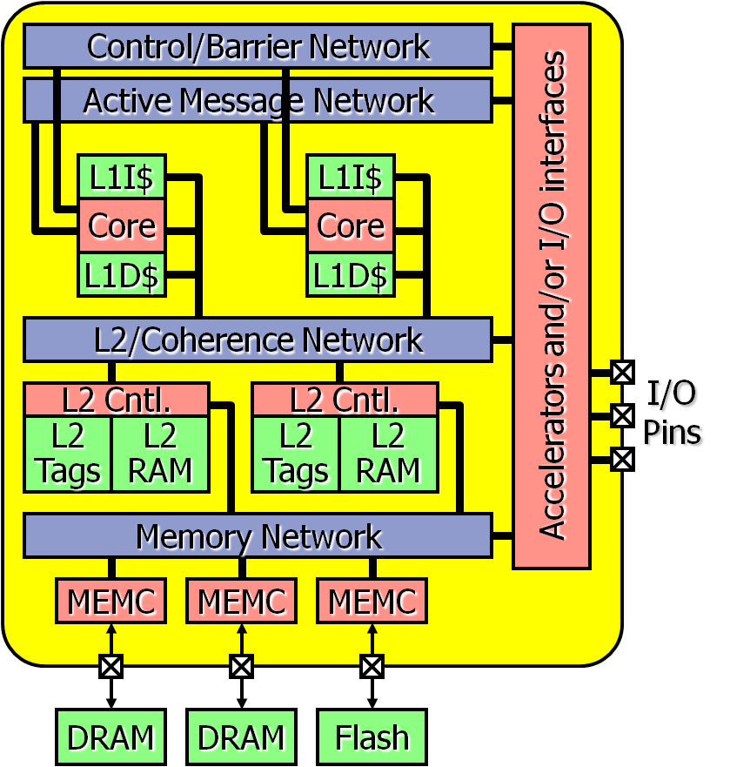
RAMP Gold: FAST Emulation of new Hardware
RAMP emulation model for Parlab manycore
SPARC v8 ISA -> v9
Considering ARM model
Single-socket manycore target
Split functional/timing model, both in hardware
Functional model: Executes ISA
Timing model: Capture pipeline timing detail (can be cycle accurate)
Host multithreading of both functional and timing models
Built for Virtex-5 systems (ML505 or BEE3)
Timing Model Pipeline
Functional Model Pipeline
Timing State
Arch State
Notes:
34

Slide 35
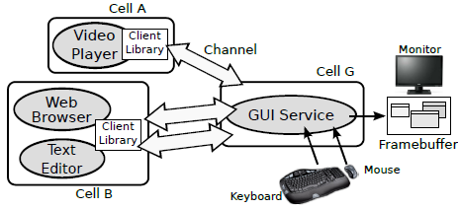
GUI Service Example
GUI service (GuiServ) runs in its dedicated cell and interacts with application cells via channels.

Slide 36
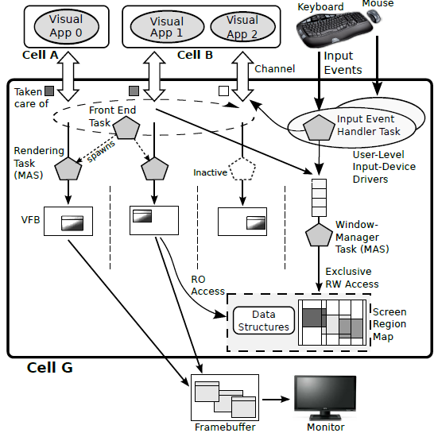
GuiServ Details
Rendering Tasks, responsible for rendering graphics and video processing requests
Input Event Handler Tasks, which forward input events from human-interface devices to clients and/or the service
Window-Manager (WM) Task, responsible for window creation, movement, and destruction.
Each scheduled with Multiprocessor Aperiodic Servers (MASs) under the Multiprocessor Constant-Bandwidth Server (M-CBS) scheme

Slide 37
Conclusion
Space-Time Partitioning: grouping processors & resources behind hardware boundary
Two-level scheduling
Global Distribution of resources
Application-Specific scheduling of resources
Bare Metal Execution within partition
Composable performance, security, QoS
Cells: Basic Unit of Resource and Security
User-Level Software Component with Guaranteed Resources
Secure Channels to other Cells
Partitioning Service
Explicit Admission Control: Sometimes requests for resources must be denied
Policy-driven optimization of resources
Tessellation OS
Exploded OS: spatially partitioned, interacting services
Exploit Hardware partitioning mechanisms when available
Components
Partitioning Mechanisms (“NanoVisor”)
Policy Service: Resource Management
OS services as independent servers
Notes:
Space-Time Partitioning: grouping processors & resources behind hardware boundary
Focus on Quality of Service
Two-level scheduling
Composable performance, security, QoS
Tessellation OS
Exploded OS: spatially partitioned, interacting services
Components
NanoVisor: Partitioning Mechanisms
Policy Manager: Partitioning Policy, Security, Resource Management
OS services as independent servers
Global Distribution of resources
Application-Specific scheduling of resources
Bare Metal Execution within partition
First version of Tessellation
~7000 lines of code in NanoVisor layer
Supports basic partitioning
Cores and caches (via page coloring)
Fast inter-partition channels (via ring buffers in shared memory, soon cross-network channels)
Network Driver and TCP/IP stack running in partition
Devices and Services available across network
Hard Thread interface to Lithe – a framework for constructing user-level schedulers
Currently Two ports
4-core Nehalem system
64-core RAMP emulation of a manycore processor (SPARC)
Will allow experimentation with new hardware resources
Examples:
QoS Controlled Memory/Network BW
Cache Partitioning
Fast Inter-Partition Channels with security tagging

Slide 38
Multikernel/BarrelFish (ETHZ, Microsoft)
Andrew Baumann, Paul Barham, Pierre-Évariste Dagand, Timothy L. Harris, Rebecca Isaacs, Simon Peter, Timothy Roscoe, Adrian Schüpbach, Akhilesh Singhania: The multikernel: a new OS architecture for scalable multicore systems. SOSP 2009: 29-44

Slide 39
Multikernel Design Philosophy
Distributed system on a chip
Structure the OS as a distributed system
A copy of kernel on every core
Make inter-core communication explicit
Make OS structure hardware-neutral
View state as replicated
Notes:
I Data structures protected by locks
I Anything else is a device
12.10.2009

Slide 40
Explicit Inter-Core Communication
All communication with messages (no shared state)
Naturally supports heterogeneous cores, non-coherent interconnects (PCIe)
Better match for future hardware
with cheap explicit message passing (e.g. Tile64)
without cache-coherence (e.g. Intel 80-core)
Allows split-phase operations
Decouple requests and responses for concurrency
Notes:
I Decouples system structure from
inter-core communication mechanism
I Communication patterns explicitly expressed

Slide 41
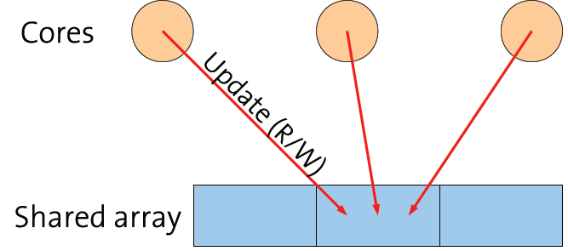
Conventional Shared Memory
Each core updates the same memory locations
Cache-coherence protocol migrates modified cache lines
Processor stalled while line is fetched or invalidated
Limited by latency of interconnect round-trips
Performance depends on data size (cache lines) and contention (number of cores)

Slide 42
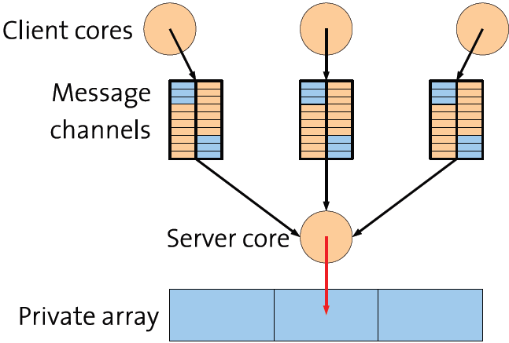
Message Passing
A single server core updates the memory locations
Each client core sends RPCs to the server
Operation and results described in a single cache line
Block while waiting for a response
Notes:
(move the operation to the data):

Slide 43
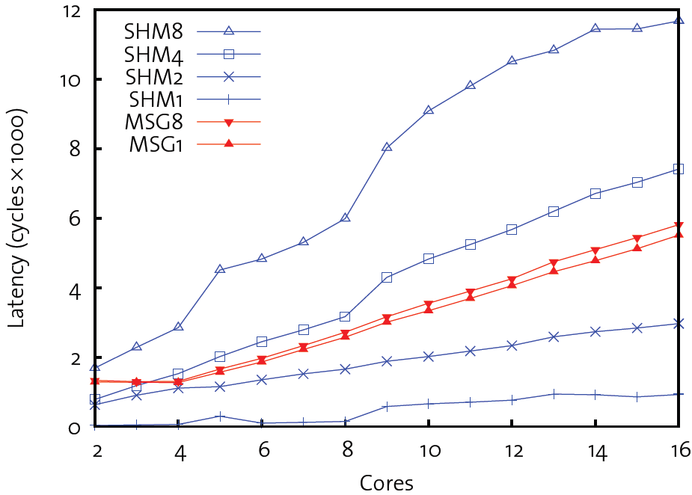
Shared Memory vs. Msg Passing (4x4 core AMD Processor)

Slide 44
Replicated State
Potentially-shared state accessed as if it were a local replica
Scheduler queues, process control blocks, etc.
Required by message-passing model
Naturally supports domains that do not share memory
Naturally supports changes to the set of running cores
Hotplug, power management

Slide 45
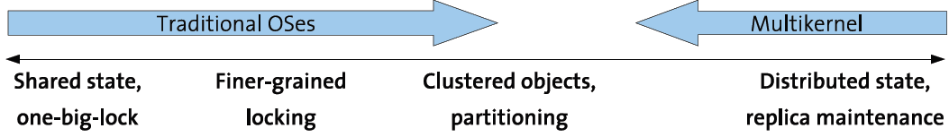
Replication vs. Sharing as Default
Replicas used as an optimisation in previous systems:
Tornado, K42 clustered objects
Linux read-only data, kernel text
In a multikernel, sharing is a local optimisation
Shared (locked) replica for threads or closely-coupled cores
Hidden, local
Only when faster, as decided at runtime
Notes:
I Basic model remains split-phase

Slide 46
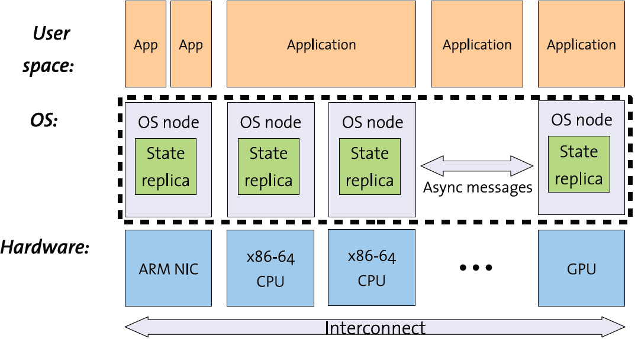
Multikernel Architecture

Slide 47
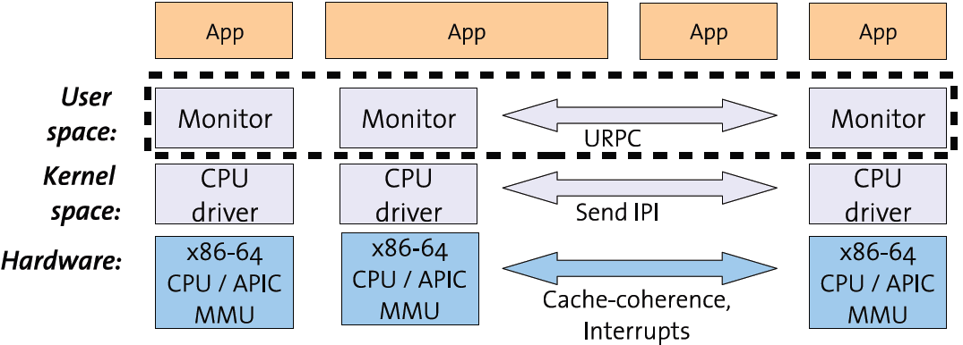
Barrelfish: an Implementation of Multikernel
CPU driver serially handles traps and exceptions
Monitor mediates local operations on global state
URPC inter-core (shared memory) message transport on current (cache-coherent) x86 HW
Notes:
Barrellfish [2]: It uses a multi-kernel model which calls for multiple independent OS instances communicating via explicit messages. Barrelfish factors the OS instance on each core into a privileged-mode CPU driver and a distinguished user-mode monitor process. CPU drivers are purely local to a core, and all inter-core coordination is performed by monitors. The distributed system of monitors and their associated CPU drivers encapsulate the functionality found in a typical monolithic microkernel such as scheduling, communication, and low-level resource allocation. The rest of Barrelfish consists of device drivers and system services (such as network stacks, memory allocators, etc.) which, run in user-level processes as in a microkernel. Device interrupts are routed in hardware to the appropriate core, demultiplexed by that core‟s CPU driver, and delivered to the driver process as a message.
Factored Operating System (FOS) [3]: According to the authors, “FOS is a new operating system targeting many-core systems with scalability as the primary design constraint, where space sharing replaces time sharing to increase scalability. We describe fos which is built in a message passing manner, out of a collection of Internet inspired services. Each operating system service is factored into a set of communicating servers which in aggregate implement a system service. These servers are designed much in the way that distributed Internet services are designed, but instead of providing high level Internet services, these servers provide traditional kernel services and replace traditional kernel data structures in a factored, spatially distributed manner. fos replaces time sharing with space sharing. In other words, fos's servers are bound to distinct processing cores and by doing so do not fight with end user applications for implicit resources such as TLBs and caches.” They suggest redesigning traditional OSs using their approach for scalability.
4. Helios [5]: Helios is an operating system designed to simplify the task of writing, deploying, and tuning applications for heterogeneous platforms. Helios introduces satellite kernels, which export a single, uniform set of OS abstractions across CPUs of disparate architectures and performance characteristics. Access to I/O services such as file systems are made transparent via remote message passing, which extends a standard microkernel message-passing abstraction to a satellite kernel infrastructure. Helios retargets applications to available ISAs by compiling from an intermediate language. The authors compare their approach to Barrelfish as follows: Barrelfish focuses on gaining a fine-grained understanding of application requirements when
Multiprocessor techniques:
I Minimise shared state (Tornado, K42, Corey)
I User-space messaging decoupled from IPIs (URPC)
I Single-threaded non-preemptive kernel per core (K42)
Other ideas we liked:
I Capabilities for all resource management (seL4)
I Upcall processor dispatch (Psyche, Sched. Activations, K42)
I Push policy into application domains (Exokernel, Nemesis)
I Lots of information (Infokernel)
I Run drivers in their own domains (kernels)
I EDF as per-core CPU scheduler (RBED)
I Specify device registers in a little language (Devil)

Slide 48
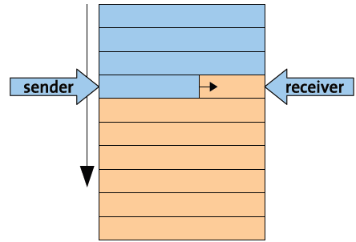
URPC
Current hardware provides one communication mechanism: cache-coherent shared memory
Can we “trick” cache-coherence protocol to send messages?
User-level RPC (URPC)
Channel is shared ring buffer
Messages are cache-line sized
Sender writes message into next line
Receiver polls on last word
Instead of using IPI (Inter-Processor Interrupts)
Notes:
Marshalling/demarshalling, naming,
binding all implemented above

Slide 49
Multikernel Conclusions
Modern computers are inherently distributed systems
It’s time to rethink OS structure to match
The Multikernel: model of the OS as a distributed system
1. Explicit communication, replicated state
2. Hardware-neutral OS structure
Barrelfish: concrete implementation
Reasonable performance on current hardware
Better scalability/adaptability for future hardware

Slide 50
Corey OS (MIT)
Silas Boyd-Wickizer, Haibo Chen, Rong Chen, Yandong Mao, M. Frans Kaashoek, Robert Morris, Aleksey Pesterev, Lex Stein, Ming Wu, Yue-hua Dai, Yang Zhang, Zheng Zhang: Corey: An Operating System for Many Cores. OSDI 2008: 43-57

Slide 51
Goal of Corey
New OS interfaces that help applications scale with the number of cores.
Target applications: Web servers, MapReduce, mail servers, ...
“The kernel should arrange each data structure so that only a single processor need update it, unless directed otherwise by the application.”
Goal: Alleviate bottleneck of accessing shared OS data structures
Contention on shared data structures is costly:
Serialization
moving data between caches
Notes:
● Why does the OS need shared data
structures?
– OS semantics requires it
– Simplifies resource management

Slide 52
Current practice for scaling the OS
Redesign and re-implement kernel subsystems
Fine grained locking, RCU (Read-Copy-Update), etc.
Lots of work: continuous redesign to increase concurrency
Linux changes: page cache, scheduler, RCU, memory management, ...
Existing interfaces constrain designers
Even a small amount of shared kernel data limits performance with many cores

Slide 53
Corey’s Solution
Applications don't always need to share all the data structures that existing interfaces share
Allow applications to control how cores share kernel data structures
Avoid contention over kernel data structures
Propose three interface changes
shares, address ranges, kernel cores

Slide 54
New OS Interfaces
Shares: a mechanism for applications to control precisely how kernel structures are shared;
Address ranges: control which page-table entries are private to a core and which ones are shared;
Kernel cores: allow space-separation of kernel functions and applications, by defining a set of cores dedicated exclusively to the kernel

Slide 55
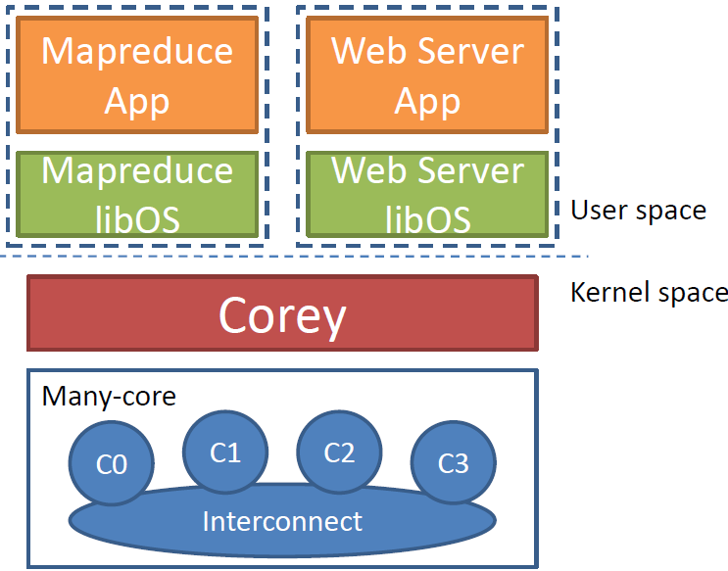
Corey Architecture
Sharing abstractions provided as part of a set of user-level library Oses
libOS – provides basic C lib functions, efficient inter-core dynamic memory allocation, forking, efficient file sharing, and network access

Slide 56
OS Kernel Object Sharing
Traditional approach: Kernel must map an application-visible reference into address of kernel object
Typically via per-process or global tables
Cores contend for shared data
Example: Shared kernel data structure: file descriptor table
Measure the cost of using FD table
Threads dup-and-close a per-thread FD
16 core AMD Opteron running Linux 2.6.27

Slide 57
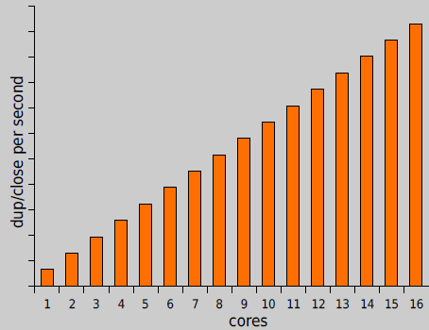
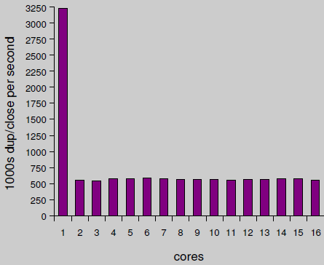
Expected vs. Actual Performance
Expected Throughput
Actual Throughput

Slide 58
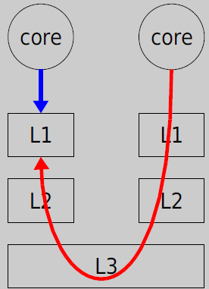
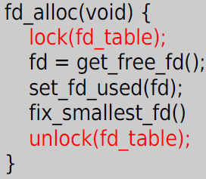
FD Table is Global Shared Resource
Shared FD table is a bottleneck
A global lock serializes updates to fd_table

Slide 59
Problem
For some applications the OS shares kernel data structures unnecessarily
Should be able to improve performance
Challenge: how should the OS figure out when to share and when not to?

Slide 60
Solution: Shares
Shares allow applications to control how cores share the kernel data structures used to do lookups
Applications specify when they need sharing, for example:
shared FDs allocated in shared table
private FDs allocated in private table
Corey kernel uses shares for all lookup tables
Implementation in Linux:
FD system calls (sys_open, sys_dup, ...) take an optional shareid/fdtableid argument.

Slide 61
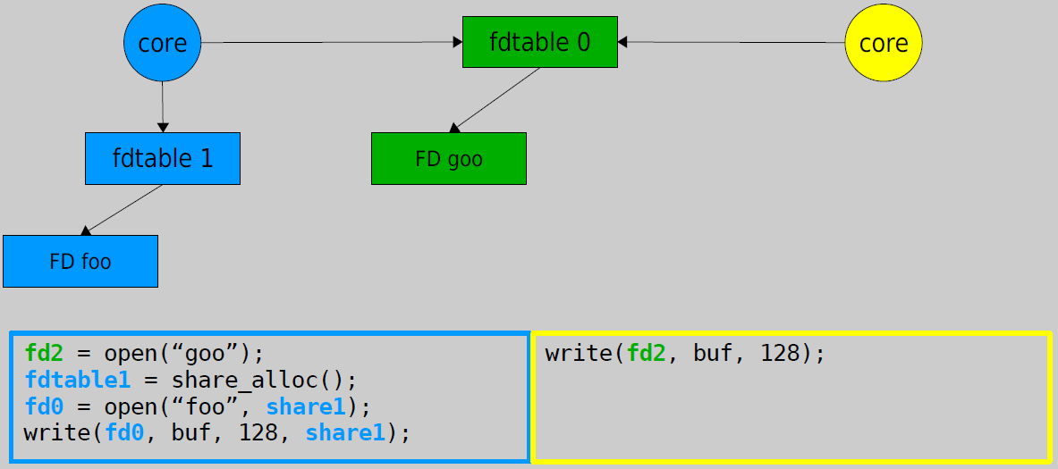
Linux Shares Example
fd2 (green) is shared; fd0 (blue) is private.
Cores manipulate private FDs without contending for kernel data structures

Slide 62
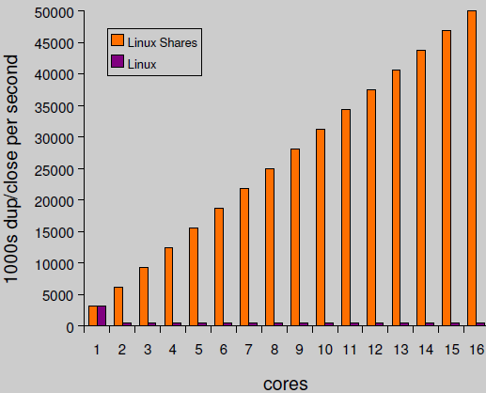
Linux Shares Has Ideal Performance
Avoid contention on shared FD table:
No drop in throughput (no L1 misses)
Scales linearly (no serialization)

Slide 63
Benefits of Shares
Able to avoid unnecessary contention on kernel data structures
For example when application threads do not share FDs
Applications can control how cores share internal kernel data structures
Few kernel and application modifications to get scalability

Slide 64
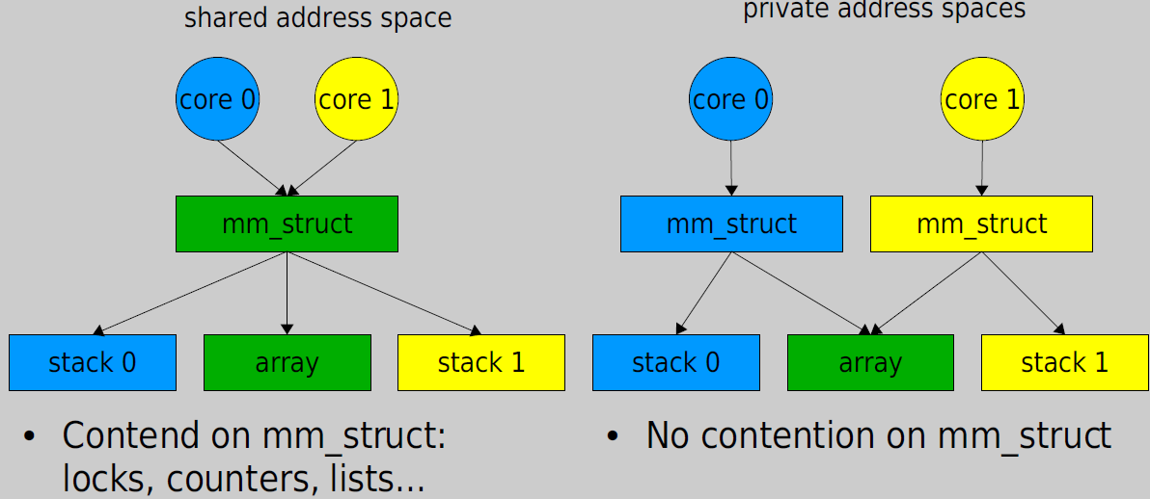
Two Options for MP Shared-Memory
Shared address space
Implemented with multiple threads
Private address spaces
Implemented with multiple processes
Share memory with mmap(MAP_SHARED)

Slide 65
Problem
Neither option accurately represents how the application is using kernel data structures:
shared address spaces – the mm_struct is global
Contention
unnecessary for private memory
private address spaces – the mm_struct is private
extra soft page faults, because no PTE sharing

Slide 66
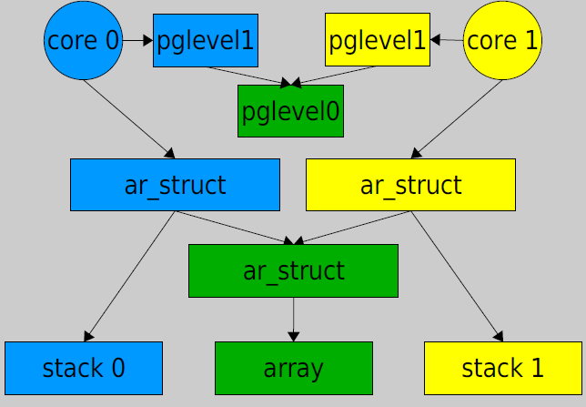
Address Ranges
Each core have a private “root” address range that maps private memory (blue and yellow)
May be a shared address range (green)
Page tables can be private (blue and yellow) or shared (green)
When one core faults on a shared page and fills in the PTE in pglevel0 (shared), the PTE is part of the other core‘s page table.

Slide 67
Benefits of Address Ranges
Address ranges provide benefits of both shared and private address spaces:
Avoid contention for private memory
Share PTEs for shared memory
Applications control how cores share internal OS data structures
Few application modifications to improve scalability
Notes:
Able to avoid contention, but able to share what is necessary

Slide 68
Kernel Cores
LibOS can dedicate one or more CPU cores to execute a kernel
Kernel core can manage devices and execute system calls (either local or through shared memory IPC)
Dedicated core reduces contention costs
Eliminate user/kernel context switch time for syscalls
Asynchronous syscalls

Slide 69
Corey vs. Multi-Kernel
Corey
Try to localize, share when not possible
Shared Memory
Hardware layout (NUMA) important for performance
Multi-kernel
State replicated on each core
Message Passing
Hardware layout (NUMA) important for performance
Notes:
No system wide knowledge
System wide knowledge
–Scalability sub-optimal
–Speculates on future hardware

Slide 70
Corey OS Summary
New OS interfaces that help applications scale with the number of cores
Allow applications to control how cores share kernel data structures
Avoid contention from unnecessary sharing
Share state when its beneficial

Slide 71
Helios (Microsoft)
Edmund B. Nightingale, Orion Hodson, Ross McIlroy, Chris Hawblitzel, Galen C. Hunt: Helios: heterogeneous multiprocessing with satellite kernels. SOSP 2009: 221-234
Notes:
Helios is an operating system designed to simplify the task of writing,
deploying, and tuning applications for heterogeneous platforms.
Helios introduces satellite kernels, which export a single, uniform
set of OS abstractions across CPUs of disparate architectures and
performance characteristics. Access to I/O services such as file
systems are made transparent via remote message passing, which
extends a standard microkernel message-passing abstraction to a
satellite kernel infrastructure. Helios retargets applications to available
ISAs by compiling froman intermediate language. To simplify
deploying and tuning application performance, Helios exposes an
affinity metric to developers. Affinity provides a hint to the operating
system about whether a process would benefit from executing
on the same platform as a service it depends upon.

Slide 72
Helios
Helios manages ‘distributed system in the small’
export a single-kernel image across heterogeneous coprocessors to make it easy for applications to take advantage of new hardware platforms.
Provide single programming model for heterogeneous hardware devices
4 techniques to manage platform heterogeneity
Satellite kernels: Same OS abstraction across CPUs of disparate architectures and performance characteristics.
Remote message passing: Transparent IPC between kernels
Affinity: Easily express arbitrary placement policies to OS
2-phase compilation: Run apps on arbitrary devices
Notes:
NUMA is treated as shared-nothing multiprocessor.

Slide 73
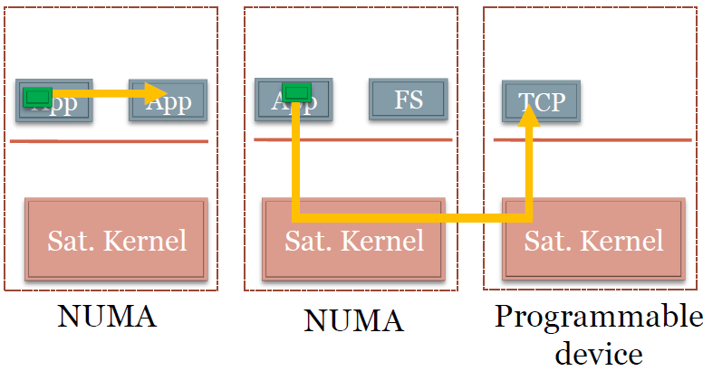
Sat Kernels & RPC
Satellite kernels:
Efficiently manage local resources
Apps developed for single system call interface
μkernel: Scheduler, memory manager, namespace manager
IPC:
Local IPC uses zero-copy message passing
Remote IPC transparently marshals data
Unmodified apps work with multiple kernels

Slide 74
Where Should a Process Execute?
Three constraints impact initial placement decision
1.Heterogeneous ISAs makes migration difficult
2.Fast message passing may be expected
3.Processes might prefer a particular platform
Helios exports an affinity metric to applications
Affinity is expressed in application metadata and acts as a hint
Positive represents emphasis on communication - zero copy IPC
Negative represents desire for non-interference

Slide 75
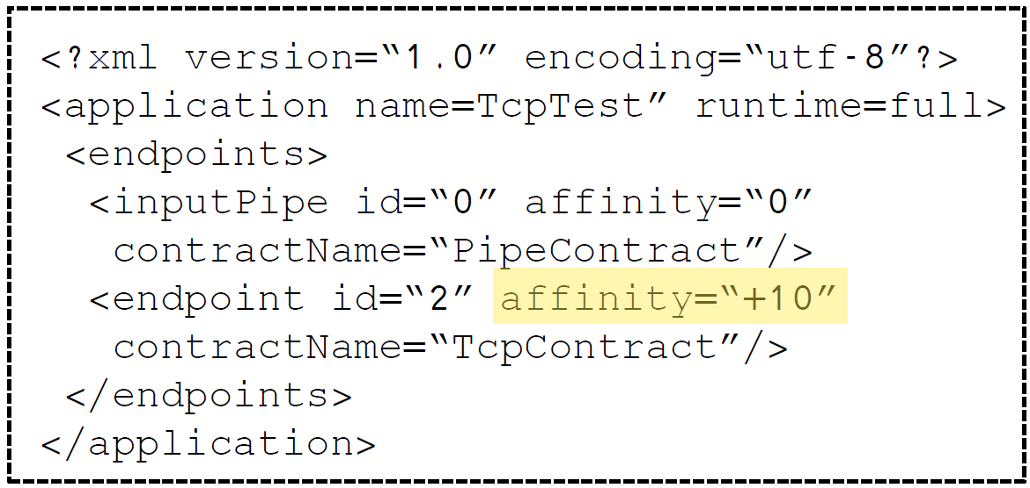
Affinity Expressed in Manifests
stdin is represented in the manifest and has an affinity value of 0, which means that the process does not care where it executes in relation to the stdin process.
The second message-passing channel listed in the example is a connection to the Helios TCP service. The process lists an affinity value of -1, which means the process expresses a wish to execute on a satellite kernel that differs from the kernel that is servicing TCP packets and sockets.
Notes:
Every process has at least two message-passing channels,
stdin and stdout, connected to it by default. In Figure 2, stdin is
represented in the manifest and has an affinity value of 0, which
means that the process does not care where it executes in relation

Slide 76
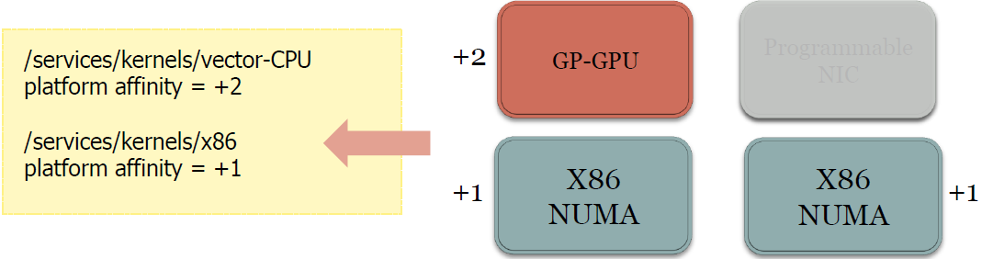
Platform Affinity
Platform affinity processed first
Guarantees certain performance characteristics
Notes:
manifest is an XML file that is automatically
generated when a process is compiled into CIL, and it
contains a list of message-passing channels the process depends
upon.

Slide 77
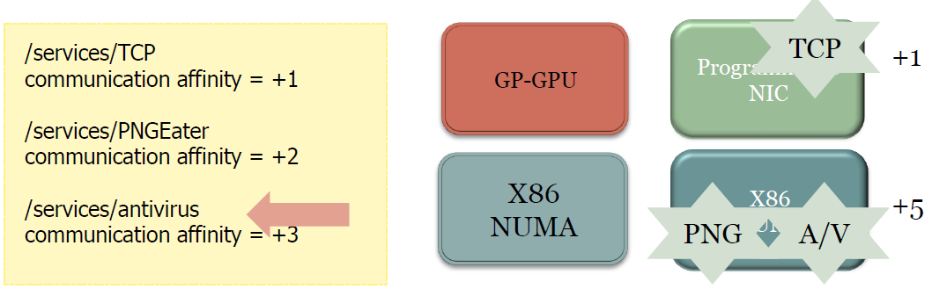
Comm Affinity (Positive)
Represents ‘tight-coupling’ between processes
Ensure fast message passing between processes
Positive affinities on each kernel summed

Slide 78
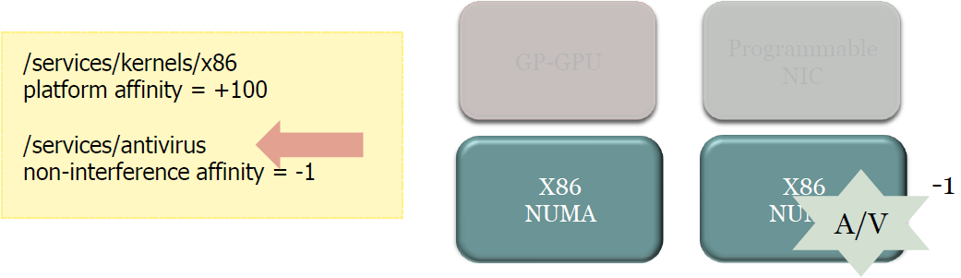
Negative Affinity
Expresses a preference for non-interference
Used as a means of avoiding resource contention
Negative affinities on each kernel summed

Slide 79
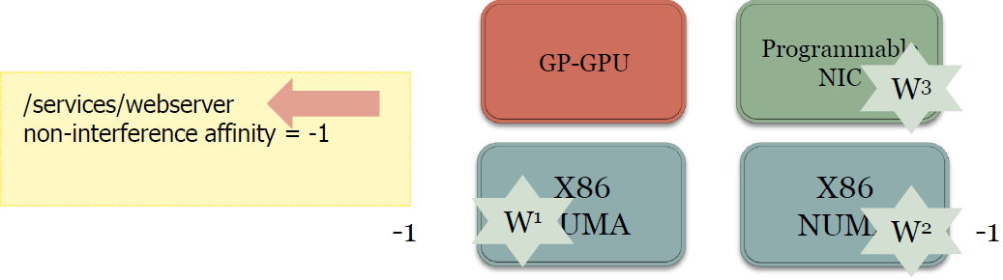
Self-Reference Affinity

Slide 80
Turning Policies into Actions
Priority based algorithm reduces candidate kernels by:
First: Platform affinities
Second: Other positive affinities
Third: Negative affinities
Fourth: CPU utilization
Attempt to balance simplicity and optimality

Slide 81
Encapsulating Many Architectures
Two-phase compilation strategy
All apps first compiled to MSIL
At install-time, apps compiled down to available ISAs
MSIL encapsulates multiple versions of a method
Example: ARM and x86 versions of Interlocked.CompareExchangefunction

Slide 82
Implementation
Based on Singularity operating system
Added satellite kernels, remote message passing, and affinity
Xscale programmable I/O card
2.0 GHz ARM processor, Gig E, 256 MB of DRAM
Satellite kernel identical to x86 (except for ARM asm bits)
Roughly 7xslower than comparable x86
NUMA support on 2-socket, dual-core AMD machine
2 GHz CPU, 1 GB RAM per domain
Satellite kernel on each NUMA domain.

Slide 83
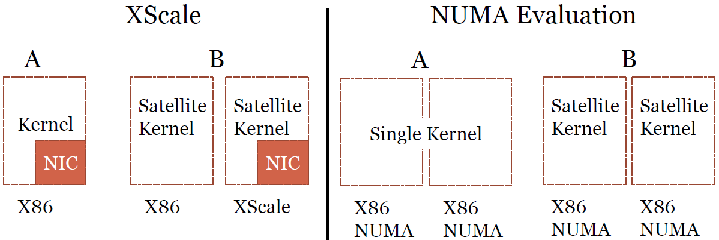
Evaluation Platform

Slide 84
Helios Summary
Helios manages ˉdistributed system in the smallˇ
Simplify application development, deployment, tuning
4 techniques to manage heterogeneity
Satellite kernels: Same OS abstraction everywhere
Remote message passing: Transparent IPC between kernels
Affinity:Easily express arbitrary placement policies to OS
2-phase compilation:Run apps on arbitrary devices
Offloading applications with zero code changes

Slide 85
K42 OS
Microkernel OS Developed by IBM & University of Toronto since 1998, targeting NUMA multicore processors

Slide 86
K42 Scheduling
User-Level
Threads
User-Level
Threads
Address Space
User Space
Dispatcher
Dispatcher
User-Level
Threads
User-Level
Threads
CPU Domain
Dispatcher
Descriptor
Scheduling
Class 1
Kernel Space
Scheduling
Class 2

Slide 87
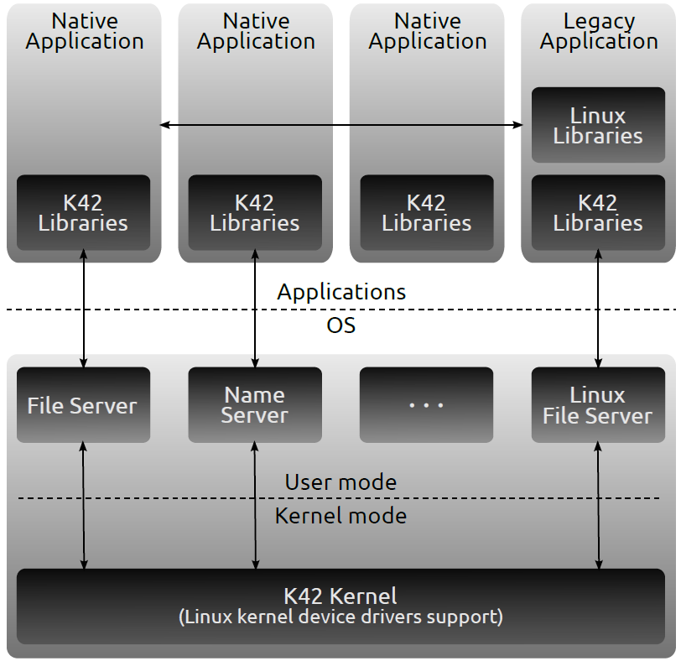
K42 OS Architecture
Scalability
Shared Memory MPs
NUMA Architecture
64-bit OS
Object-Oriented
Modularity
Customizability
Uniformity
Scalability
Micro-kernel based
Customizability
Performance
Linux Compatibility
API Compatible
Binary Compatible

Slide 88
K42 Autonomic Capabilities
OO design allows the support of online reconfiguration and dynamic update through hot-swap
monitoring code, diagnostic code and implementations can be dynamically inserted and removed in functioning systems
e.g., caches and memory management policies can be changed at runtime, taking into consideration the current data access patterns in order to always use the best performing policy

